Slide 1
Motivating Scientists to Engage...
Sophie Duncan
National Co-ordinating Centre for Public Engagement, UK
Funded by the Higher Education Funding Councils, Research Councils UK and The Wellcome Trust

Slide 2
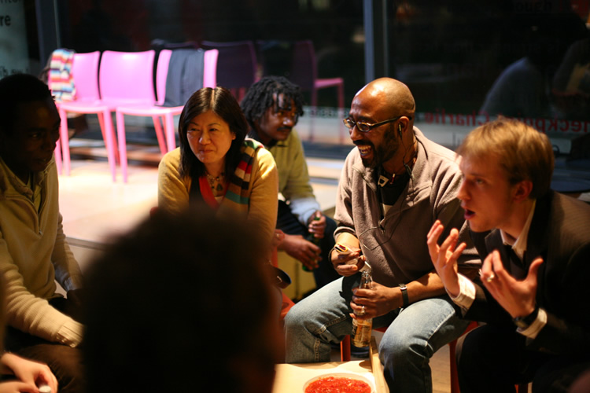

Slide 3
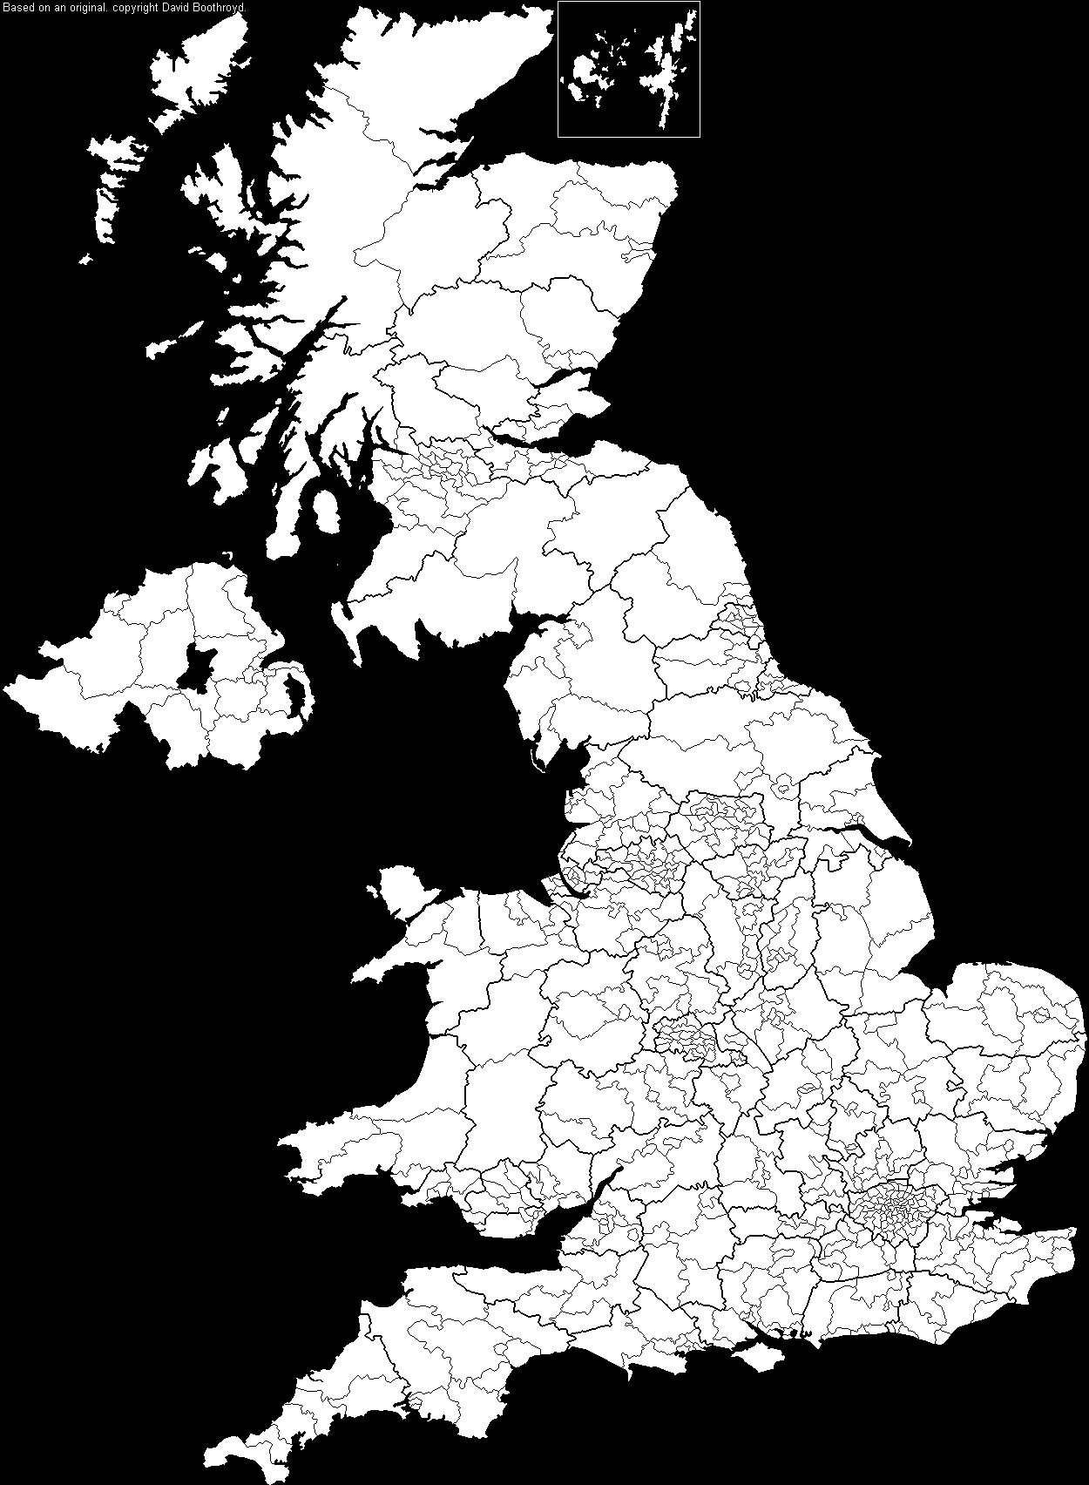




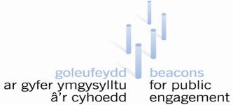

Manchester Beacon
connecting people, place & knowledge
PUBLIC ENGAGEMENT UNIT

Slide 4
Focal points for embedding engagement
PURPOSE
Embedding a commitment to public engagement in institutional mission and strategy, and championing that commitment at all levels
PROCESS
Investing in systems and processes that facilitate involvement, maximise impact and help to ensure quality and value for money
PEOPLE
Involving staff, students and representatives of the public and using their energy, expertise and feedback to shape the strategy and its delivery

Slide 5
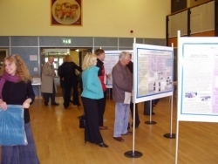


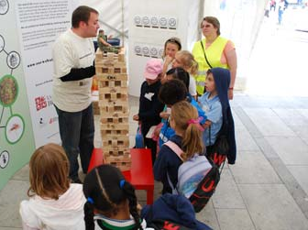



Slide 6
Why bother?
Improve research
Raise aspirations
Inspire learning
Funders requirement
Builds trust
Develop skills
Inform policy
Share research
Generate impact
Public accountability
It can be fun....
Learn from others
Make a difference
Improve relationship with communities

Slide 7
... it is an opportunity to actually feed your own confidence in your research and that has to be a good thing
Laurie Strauss
... a way of communicating to people and with people the importance of some of the questions that I do research on and particularly through engaging them ....as research assistants.
Michael Pocock
I found engaging with wider society..... has made me a better researcher.
Martin Hendry

Slide 8
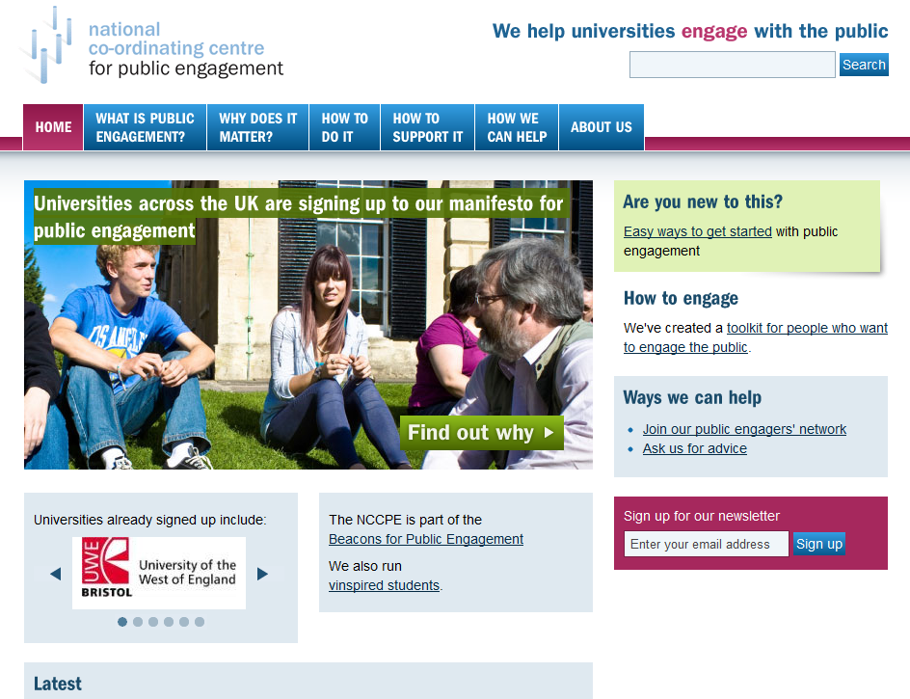

Slide 9
www.publicengagement.ac.uk
sophie.duncan@uwe.ac.uk

